Slide 1
Concurrency Control : Semaphores
Dr. Muhammad Saeed

Slide 2
Outlines
What are semaphores?
Operations on semaphores
Semaphores as locks
Semaphores as condition variables
Examples
Producer/Consumer Problem
Reader/Write Problem
Dining Philosopher Problem
Summary

Slide 3
Semaphores
Special synchronization construct
Can be used as a lock or condition variable
Provides two operations
sem_wait()
sem_post()

Slide 4
Semaphores – operations
Notes:
sempost() either returns immediately or waits
sem_post() doesn’t wait for any condition
-ve semaphore count tells the number of threads waiting

Slide 5
Semaphore – accessing critical section
Initial value of X ??
with X==1, this semaphore will behave as a lock!

Slide 6
Semaphore
Named (files stored at /dev/shm/)
sem_open((const char *name, int oflag, mode_t mode, unsigned int value)
sem_close() //value → 0,1,n
sem_unlink()
Unnamed (memory)
sem_init(sem_t *sem, int pshared, unsigned int value)
sem_destory() pshared =0 (threads only) non-zero (multiple processes)
sem_wait() / sem_trywait()
sem_post()
sem_getvalue()

Slide 7
Mutual Exclusion using Named Semaphore
long balance = 0; // (Debit/Credit on balance) sem_t *mutex;
int main(){ char* name = "/b_sem1"; //file at folder … /dev/shm/sem.b_sem1 mutex = sem_open(name, O_CREAT, 0666, 1); //1-mutual exclusion,0-sync, n-counting pthread_t t1, t2; pthread_create(&t1, NULL, credit,(void *)100); pthread_create(&t2, NULL, debit,50); pthread_join(t1, NULL); pthread_join(t2, NULL); sem_close(mutex); sem_unlink(name); printf("Value of balance is :%ld\n", balance); return 0; }
void * credit(void * val){ sem_wait(mutex); balance = balance + val; //typecasting sem_post(mutex); pthread_exit(NULL); } | void * debit(void * val){ sem_wait(mutex); balance = balance - val; //typecasting sem_post(mutex); pthread_exit(NULL); }

Slide 8
Mutual Exclusion using Un-Named Semaphore
long balance = 0; // (Debit/Credit on balance) sem_t mutex;
int main(){ //char* name = "/b_sem1"; mutex = sem_open(name, O_CREAT, 0666, 1); sem_init(&mutex, 0, 1); // 0-threads, otherwise process ; 1-mutual exclusion,0-sync, n-counting pthread_t t1, t2; pthread_create(&t1, NULL, credit,(void *)100); pthread_create(&t2, NULL, debit,50); pthread_join(t1, NULL); pthread_join(t2, NULL); //sem_close(mutex); sem_unlink(name); sem_destroy(&mutex); printf("Value of balance is :%ld\n", balance); return 0; }
void * credit(void * val){ sem_wait(&mutex); balance = balance + val; //typecasting sem_post(&mutex); pthread_exit(NULL); } | void * debit(void * val){ sem_wait(&mutex); balance = balance - val; //typecasting sem_post(&mutex); pthread_exit(NULL); }

Slide 9

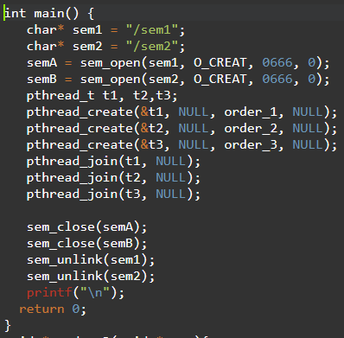
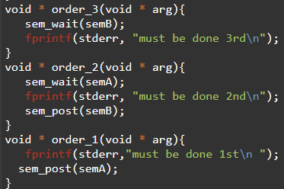

Synchronization using Semaphores

Slide 10
More Examples
As Reading Assignment
Producer/Consumer Problem (Already Discussed)
Reader/Write Problem
Dining Philosopher Problem

Slide 11
Semaphore – Producer-consumer problem
Notes:
1P1C single proc: two cases: 1. consumer runs first. 2. producer runs first. Max 10
mPmC: Max 10. problem: multiple producers access critical section simultaneously in put()

Slide 12
Semaphores – Producer Consumer with mutual exclusion
Notes:
Locks solve the race condition problem by providing mutual exclusion.
Introduce another problem: deadlock: Consumer runs first!

Slide 13
Semaphore – Producer consumer (correct)

Slide 14
Readers-Writers Problem
Let’s say a concurrent operations happen on a global linked-list
Of two kinds:
Write(), modify the list
Read(), simply read list data
Multiple threads
Can we have multiple reads in parallel? How?

Slide 16
Dining Philosophers Problem
N philosophers sitting on a table
N forks b/w them. One b/w each pair.
A philosopher can do two things:
Philosophize ( no need of forks)
Eat (needs both forks: left and right)
A philosopher can only do one of the two things at a time

Slide 17
Dining Philosophers Problem … contd.
Implement get_forks() and put_forks() such that:
There’s no deadlock
No philosopher starves
As much concurrency as
possible

Slide 18
Dining Philosophers - implementation
Five semaphores (one for each fork)
Initialize each semaphore to 1
Notes:
Problem: Deadlock. Each acquires left of it.

Slide 19
Dining Philosophers – breaking deadlock
Break the dependency!
Let at least one philosopher acquire forks in different order!

Slide 20
Semaphores – an implementation
Notes:
Doesn’t respect the invariant: -ve number represents threads waiting.
Value never goes below zero.

Slide 21
Summary
Semaphores are a simple, powerful and flexible primitive for writing concurrent programs
Semaphores provide a general solution that can operate as a lock or condition variable

